Slide 1
HOTEL RESERVATION & CANCELLATION PREDICTION
Siva DATHA CHITIKELA – 119CS0024

Slide 2
PROBLEM STATEMENT
Given a dataset containing data of reservations made by customers in different hotels. Build a machine learning model to predict whether the customer cancels his/her hotel reservation or not.

Slide 3
GIVEN DATA SET
Rows = 119390
Attributes =32
Independent variables = 31

Slide 4
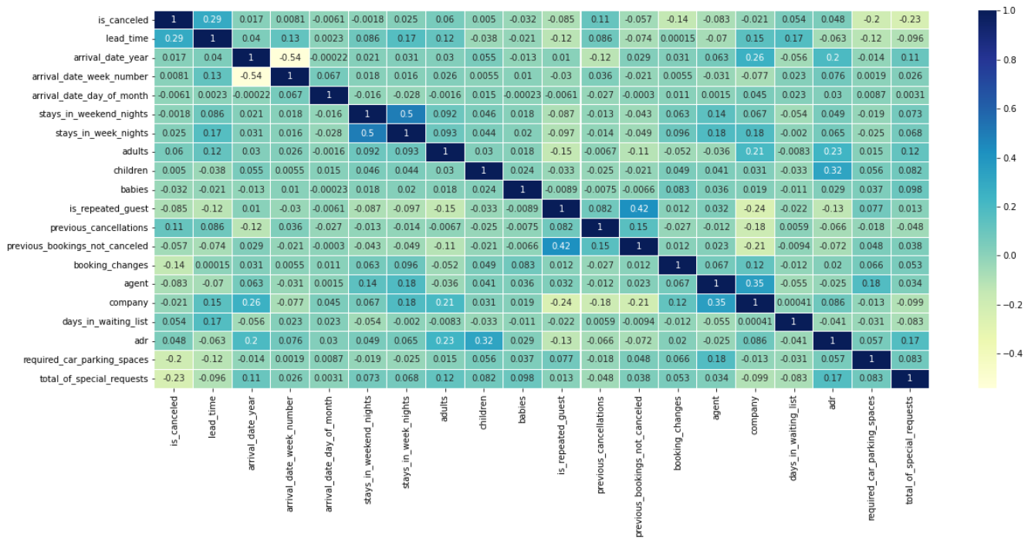
CORRELATION MATRIX

Slide 5

DATA PREPROCESSING
Data Cleaning:
Data cleaning is the process of fixing or removing incorrect, corrupted, incorrectly formatted, duplicate, or incomplete data within a dataset.

Slide 6
REPLACING NULL/MISSING VALUES
Replacing numerical missing values with Mean/Median
X=dataframe[‘column’].mean()
dataframe[‘column’] = da[‘column’].replace(np.nan,X)
Or
X=dataframe[‘column’].median()
dataframe[‘column’] = da[‘column’].replace(np.nan,X)
Replacing categorical missing values with Mode
mode= dataframe[‘column’].mode()
dataframe[‘column’] = dataframe[‘column’] replace(np.nan,mode)

Slide 7
REMOVING DUPLICATE VALUES
duplicate = dataframe.duplicated()
dataframe.drop_duplicates()
Number of Rows in the data set = 119390
Number of duplicate values in the data set = 32013
Number of rows in the dataset after removing duplicates = 87377

Slide 8
ENCODING CATEGORIAL DATA
Encoding – In order to provide the models with the data with converted categorical values and to help them make better predictions, categorical data must first be converted into integer format, this process is known as encoding.
Label encoding technique is one approach which is used to encode categorical values.
In this method column's values are converted into numbers.
i.e.,
l = LabelEncoder()
dataframe[‘column’] = l.fit_transform(da[‘column])

Slide 9
TRAINING THE MODEL
Training Set
60%
Testing Set
40%

Slide 10
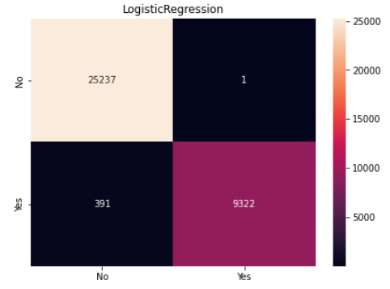
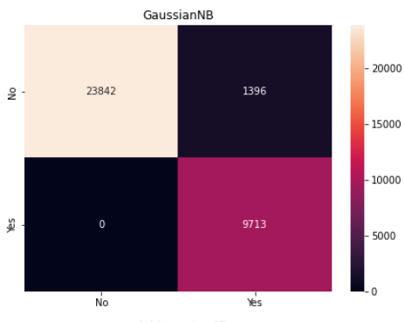
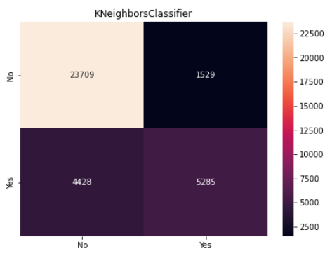
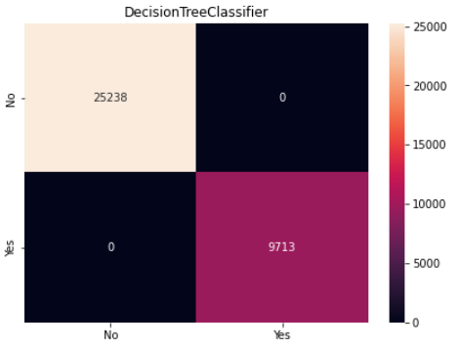
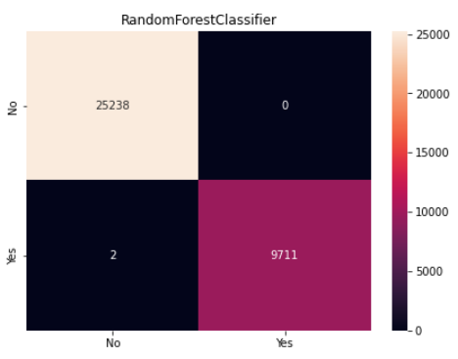
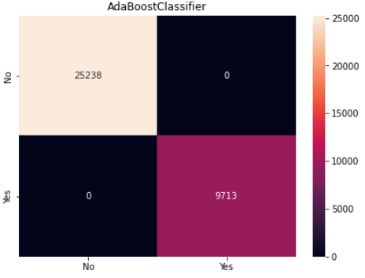
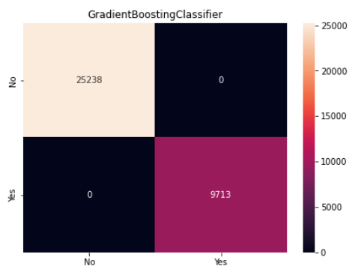
CONFUSION MATRIX

Slide 11
ACCURACY
Classifier | Training Accuracy | Testing Accuracy
Logistic Regression – LogisticRegression(solver="newton-cg“) | 0.9880593598596117 | 0.9887842980172241
Gaussian NB – GaussianNB() | 0.959466676839736 | 0.9600583674286859
KNeighbors Classifier – KNeighborsClassifier(7) | 0.8734025102048601 | 0.8295613859403165
Decision Tree Classifier – DecisionTreeClassifier(random_state=0), | 1.0 | 1.0
Random Forest Classifier – RandomForestClassifier() | 1.0 | 1.0
AdaBoost Classifier – AdaBoostClassifier() | 1.0 | 1.0
Gradient Boosting Classifier – GradientBoostingClassifier() | 1.0 | 1.0

Slide 12
CONCLUSION
The highest accuracy in this problem is obtained using the Decision Tree Classifier,
Ada Boost Classifier, and Gradient Boosting Classifier.
Highest accuracy = 100%

Slide 13
THANK YOU

